Slide 1
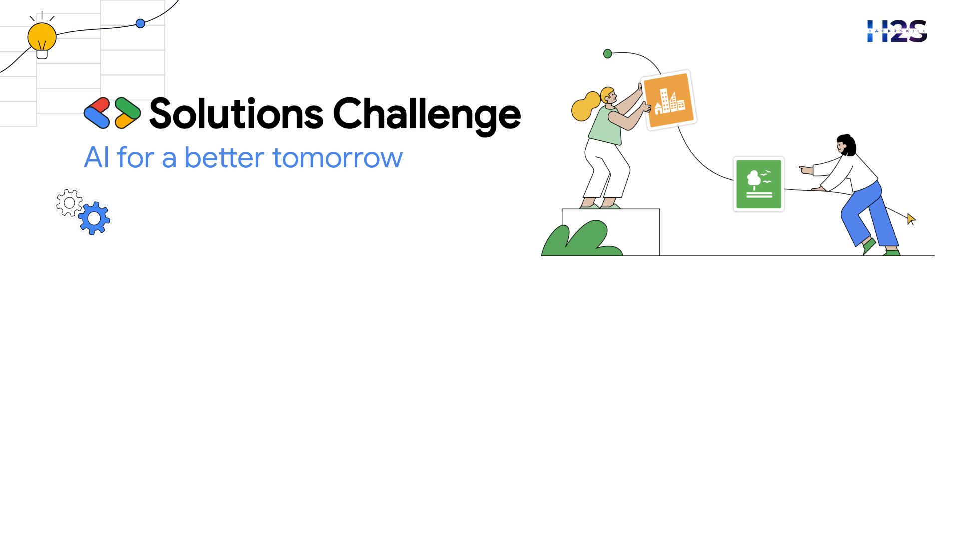

Team Details
Team name: GreenMind AI
Team leader name: V. Satya Prakash
Problem Statement: Tackling Climate Change Through Innovation and Collaboration

Slide 2

AI-Powered Climate Action Platform:
The AI-Powered Climate Action Platform is a comprehensive, intelligent system designed to help governments, businesses, and individuals effectively track emissions, optimize resource usage, and implement sustainable practices. By leveraging Gemini AI, the platform provides deep insights, predictive analytics, and personalized sustainability recommendations, enabling data-driven decision-making for climate action. IDX integration ensures decentralized, secure, and transparent data management, particularly for emissions tracking and carbon credit verification.
This modular platform incorporates real-time GHG monitoring, AI-powered sustainability advisories, blockchain-based carbon trading, and automated ESG compliance reporting. With a scalable architecture, it integrates IoT sensors, smart meters, and satellite data to provide accurate climate analytics. Additionally, its freemium business model makes it accessible to individuals while offering premium features for enterprises, such as regulatory automation and AI-powered audits.
By combining advanced AI, blockchain, and IoT technologies, this platform fosters a data-driven approach to climate action, enhancing transparency, accountability, and global sustainability efforts.

Slide 3
Key Features of the Solution
1. GHG Tracking & Analytics
The platform integrates IoT sensors, open climate databases, and satellite imagery to provide real-time emissions monitoring. AI-powered analytics process this data, identifying key emission sources and trends, enabling organizations to take proactive measures for carbon reduction.
2. Carbon Credit Marketplace
A blockchain-based carbon credit marketplace ensures transparency in carbon trading. By tokenizing carbon credits and leveraging IDX (Identity Exchange), companies and individuals can securely trade verified carbon offsets while ensuring data integrity and trust in the marketplace.
3. AI-Powered Sustainability Advisor
Using Google Gemini AI, the sustainability advisor provides personalized recommendations for individuals, businesses, and policymakers. This feature uses NLP to analyze sustainability goals, regulatory requirements, and user-specific data to suggest tailored climate action strategies.
4. Climate Resilience Forecasting
Machine learning models analyze climate patterns, extreme weather events, and geographical vulnerabilities to provide predictive insights. This feature helps organizations and communities prepare for climate-related risks, improving resilience and disaster preparedness.
5. Renewable Energy Optimization
The platform facilitates the transition to green energy by optimizing smart grids and renewable energy sources. AI-driven algorithms analyze energy consumption patterns and recommend efficient energy distribution strategies, reducing reliance on fossil fuels.
6. Crowdsourced Climate Initiatives
The platform enables community-driven sustainability projects through crowdfunding and resource sharing. Users can propose, fund, and track local green initiatives, fostering grassroots involvement in climate action.
7. Eco-Score for Businesses
An AI-powered sustainability rating system evaluates corporate ESG (Environmental, Social, and Governance) performance. Businesses receive an Eco-Score based on carbon footprint, resource efficiency, and compliance with sustainability standards.
8. Automated ESG Reporting
AI automates the generation of ESG compliance reports, ensuring regulatory adherence with minimal manual effort. The system integrates with governmental and international regulatory frameworks to streamline compliance for enterprises.

Slide 4
Architecture diagram of the proposed solution:
The platform follows a modular architecture for scalability, security, and efficiency.
Layers:
User Interface Layer – Web and mobile applications for intuitive user interactions.
AI Processing Layer (Gemini API) – Provides climate insights, predictive analytics, and NLP-driven sustainability advisory.
IoT & Data Collection Layer – Incorporates smart sensors, open climate data, and satellite integration for real-time monitoring.
Blockchain Layer (IDX Integration) – Ensures secure and decentralized carbon credit tracking and ESG reporting.
Cloud Backend & API Layer – Manages data storage, processing, and service APIs.
Machine Learning Models – Forecasts climate resilience and optimizes sustainability strategies.

Slide 5
Technologies to be used in the solution
1. AI & Machine Learning
Google Gemini API for climate analytics, NLP-based sustainability insights, and decision-making support.
ML models for forecasting emissions trends and optimizing sustainability strategies.
2. IoT & Data Sources
Smart sensors for emissions monitoring and energy tracking.
Satellite imagery integration for environmental data analysis.
Open-source climate databases for accurate reporting and forecasting.
3. Blockchain & Decentralized Data Management
IDX (Identity Exchange) for secure, decentralized storage and verification of climate data.
Smart contracts for transparent carbon credit transactions.
4. Cloud & Backend Technologies
Google Cloud and Firebase for scalable data storage and API management.
Microservices architecture for modular and flexible system components.
5. Frontend Technologies
React.js/Next.js for web applications.
Flutter for cross-platform mobile applications.
6. APIs & Integrations
Google Earth Engine for geospatial analysis.
Weather APIs for climate forecasting.
Carbon Intensity APIs for emissions tracking and analysis.

Slide 6
Additional Information
Leveraging Gemini API
Gemini AI enhances the platform’s capability by processing vast climate datasets, offering actionable insights, and providing AI-driven recommendations. NLP capabilities allow it to analyze policy documents, sustainability reports, and industry best practices to generate customized sustainability strategies.
Using IDX for Secure Data Management
IDX enables decentralized identity and data sovereignty, ensuring transparency and security in emissions tracking, carbon credit verification, and ESG reporting. This approach enhances trust in data integrity, crucial for regulatory compliance and financial transactions in carbon markets.
Business Model
Freemium Model: Basic climate tracking and sustainability insights available for free.
Premium Enterprise Offerings: Advanced analytics, automated compliance reporting, and AI-powered sustainability audits available as paid services.
Scalability of the Platform
The system is designed to integrate with national climate policies, corporate ESG frameworks, and grassroots sustainability initiatives. It supports global scalability through:
API-driven architecture for seamless third-party integrations.
Cloud-native deployment for flexible and scalable infrastructure.
Modular features that cater to different stakeholders, from individuals to multinational corporations.

Slide 7
